Slide 1
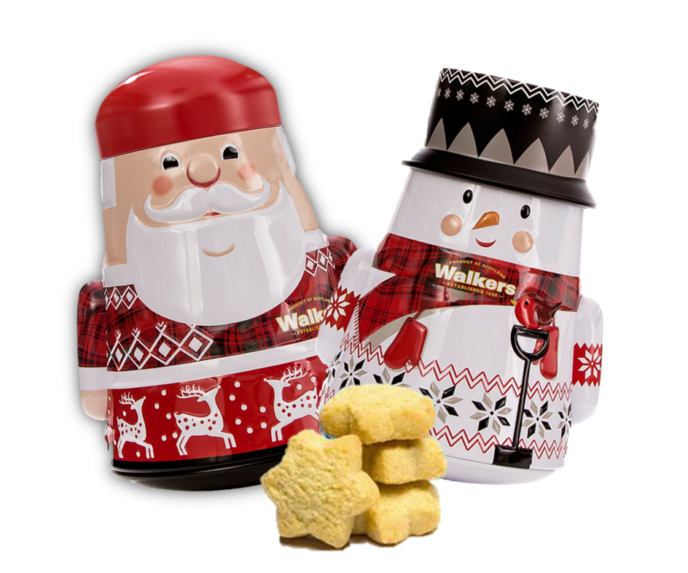
INTRODUCING
WALKERS UNIQUE TWIST
ON A TIME-HONOURED TRADITION
‘Wobbly Tins’
Yes, they really do wobble! Our pure butter shortbread mini stars are beautifully presented in these one-of-a-kind wobbly Santa & Snowman tins. They are a unique and creative gift idea. All Walkers shortbread is guaranteed to be made from only the finest ingredients possible to obtain, and contains no artificial flavourings, colourings or additives. It is certified Kosher (OUD) and is suitable for vegetarians.
www.treeoflife.ca
Toronto: 1-800-263-7054
Montreal: 1-800-363-2606
Calgary: 1-800-665-1298
Vancouver: 1-800-661-9655

Slide 2
