Slide 1
Ted Hudson
EVP Burnbrae Farms
Grocery & Specialty Food West

Slide 2

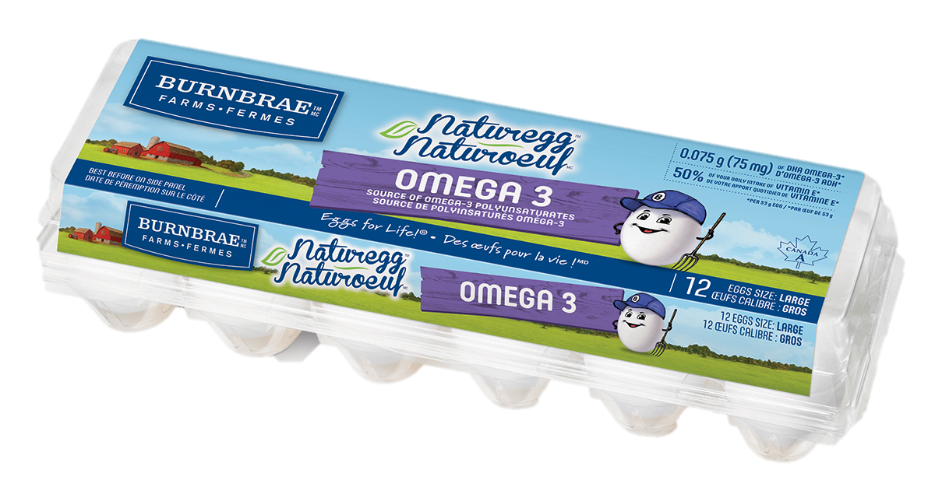
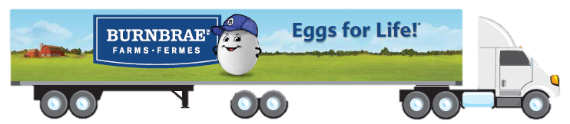
Who is Burnbrae Farms ?
National Reach
Proudly Canadian
Innovation Leader
With farms in Ontario, Quebec, Manitoba and Alberta, Burnbrae Farms is one of Canada's leading egg producers and a thriving participant in its agribusiness industry.
Farms and Processing in Ontario, Quebec, Manitoba and Alberta
Grading stations across country servicing all major retailers
Founded in 1891 by Joseph Hudson
Privately owned and Canadian
First to introduce leading innovation:
  Omega-3
  Liquid
  Many more…
13 Grand Prix Awards !!
2

Slide 3
Everything you ever wanted to know about Eggs…
Laying Hens
Canadian Supply Management System
Egg Grading
Egg Breaking

Slide 4
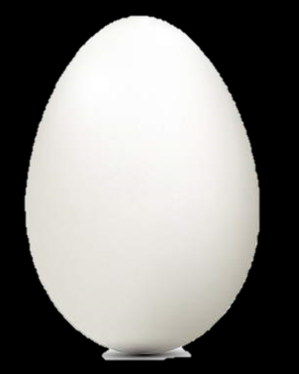
Egg Size Facts
Hens lay eggs for about a year
They start off laying pee wee, then medium, then large, then extra large and jumbo
Grading stations clean, sort, and separate the eggs
We mostly sell large and extra large to the table market
Other eggs typically go to processing

Slide 5
Egg Colour Facts
Egg colour is determined by the species of hen
Eggs can be white, brown, blue, speckled, or more !
General rule for “commercial” layers:
  Brown birds lay brown eggs
  White birds lay white eggs
They are nutritionally identical

Slide 6
Hen Feed Facts
Hens are very good at putting feed nutrients into their Eggs
There are many feed options that do impact nutrition…
  Omega 3 Flax, Vitamin E
  Omega Plus Flax, Lutein, Vitamin D & B12
  Nature’s Best Vegetarian Fed
  Organic Organic
Why Eggs? → Eggs are an easy way to get nutrients into your diet… most people eat eggs more frequently than foods like salmon

Slide 7
Eggs are Amazing !!
People need protein – especially at breakfast
Eggs are an excellent “complete” protein (all amino acids)
Excellent nutrition for early childhood, especially brain development
Very affordable – only about 25¢ !!
Lowest carbon footprint animal protein

Slide 8
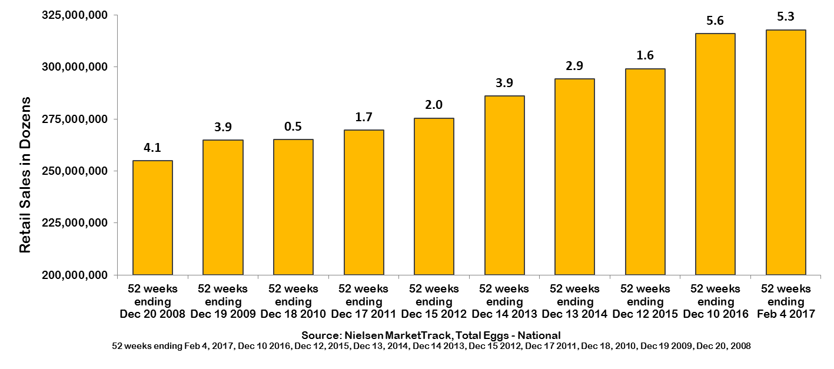
Eggs are Growing
In last 10 years… Tonnage up about 30%!!
Annual enhancements are applied to Nielsen MarketTrack to increase coverage and data quality. Enhancements impact data trends and historic data. As a result, Nielsen Canada recommends using the most current database to understand growth trends.
Courtesy: Egg Farmers of Canada

Slide 9
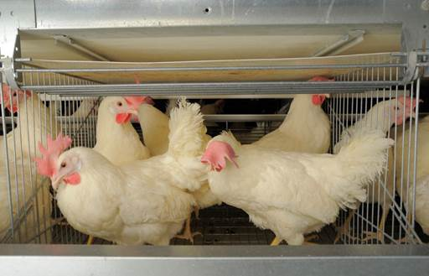
Conventional Housing Facts
Today, most hens in Canada are raised in this type of system
Enclosures designed for equal access to feed and water
Small social groups reduce aggression and separation from manure helps control disease
Code of Practice is 67 square inches per bird for white hens and 75 square inches for brown birds (which tend to be larger)

Slide 10
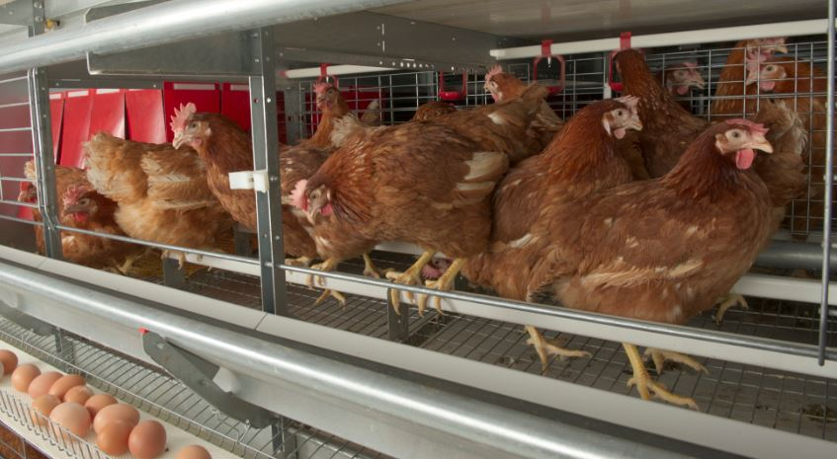
Enriched Colony Housing Facts
Similar benefits to conventional
Added perches, nesting areas, and more space per hen
The NFACC has developed a Canadian definition for enriched colony housing

Slide 11
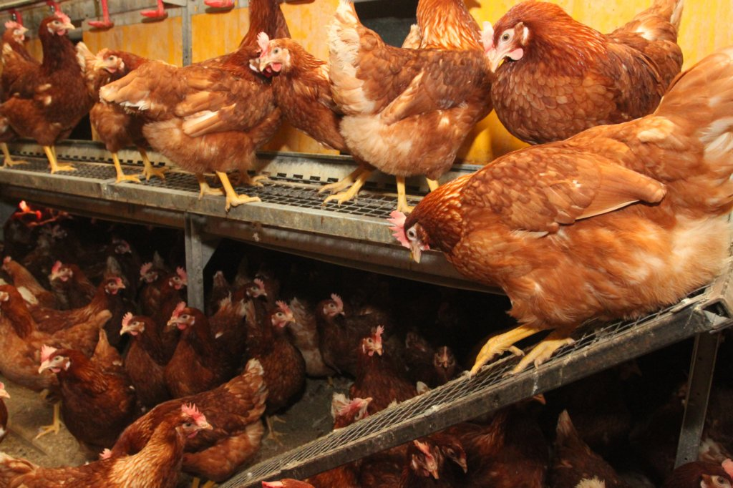
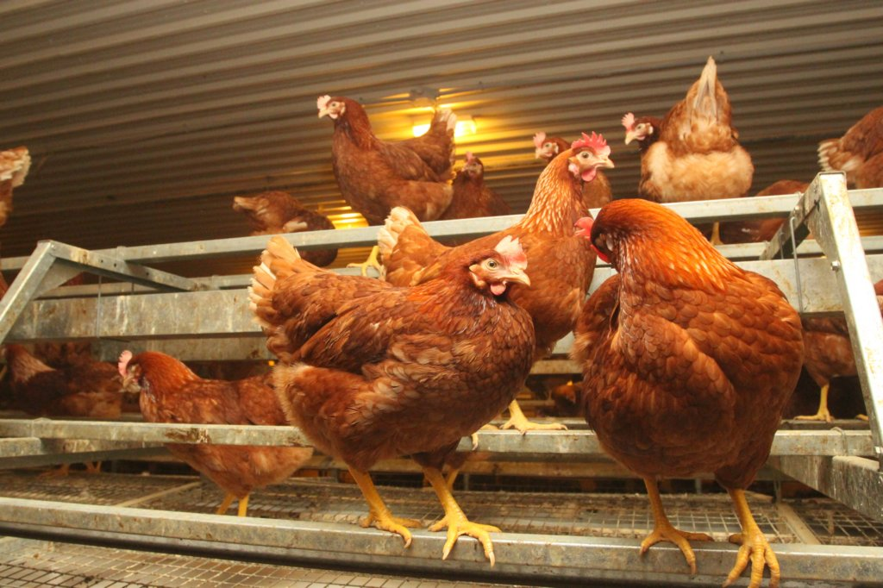
Free Run Housing Facts
Code of Practice is 144 square inches per hen (white or brown)
In addition to floor space, roosts more than double amount of space
Nest boxes allow the birds to lay their eggs in an area away from other birds.

Slide 12
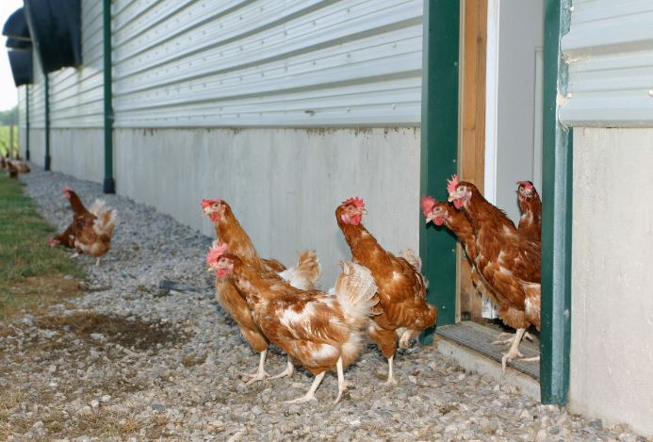
Free Range Housing Facts
Free Range hens are raised in similar conditions to the Free Run
Also have access to the outdoors - Canadian winters not always ideal
Outdoor access introduces significant disease risk due to contact with migratory birds which can carry pathogens like Avian Influenza

Slide 13
Animal Activism
What you need to know…
Activists are opposed to animal agriculture
Essentially blackmail companies with threat of shock-videos
Focused on animal rights not environment or sustainability
Increasing the cost of animal based food → Key strategy
Asking for cage free eggs now, but that is just a stepping stone
From Mercy for Animals Website:
  “We have the power to stop animal cruelty at every meal. Why? Because individuals like you are choosing to replace animal products with delicious vegan food.”

Slide 14
Objective Comparison of Housing Systems
Indicator | Conventional | Enriched | Free Run - with litter | Free Range Organic Pasture Raised
Mortality
Disease
Bumble Foot
Behaviour
Water intake
Feather loss
Husbandry
Air Quality
Food Safety
Environment
Worker Safety
Cost
Source: CSES multi-stakeholder independent research study 2015

Slide 15
Consumer Research:
General Level Of Concern
Source: SklarWilton Purple Label Research Study, June 2016, n=1000

Slide 16
Consumer Research:
“What’s Important When Buying Eggs”
What’s “Very Important” (Top 12):
Note: Could pick more than one attribute…
Source: SklarWilton Purple Label Research Study, June 2016, n=1000

Slide 17
Consumer Research:
Key Purchase Drivers
“Why do you purchase [your brand] most often?”
Note: Could only pick the most important factor…
Source: SklarWilton Purple Label Research Study, June 2016, n=1000

Slide 18
Consumer Research:
“Claimed” Purchase Preference
“Claimed” Purchase Preference After Reviewing Fact-Sheet That Explains Housing Differences & Price Premiums:
Source: SklarWilton Purple Label Research Study, June 2016, n=1000

Slide 19
“Actual” Nielsen Volume By Egg Type
Percent of Tonnage by Egg Type:
Source: ACNielsen 52wks to Feb 2017

Slide 20
Nielsen Growth By Egg Type
Percent Growth by Egg Type:
Note: Omega 3 impacted by recovery from A.I. and shift back to heavy feature of commodity vs heavy feature of O3 year ago.
Source: ACNielsen 52wks to Feb 2017

Slide 21
So… What’s Burnbrae’s perspective on Housing?
At the end of the day – Good farmers provide good hen care, regardless of the system
We support the consistent gradual phasing out of conventional cage systems
We utilize and sell eggs from all systems
We believe in transparency, consumer choice, and educating consumers on their options…

Slide 22
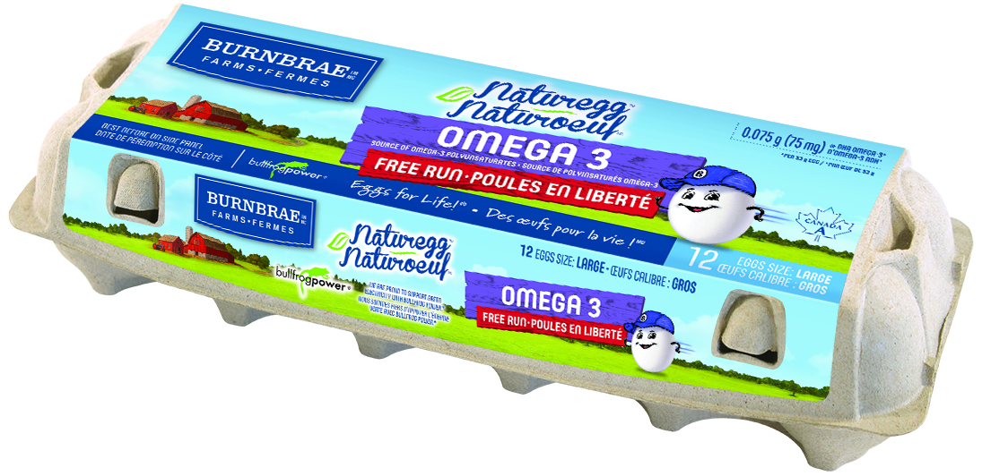
Communicating → Our new packaging
Special Feed
Nutritional claims
Egg size
Housing type

Slide 23
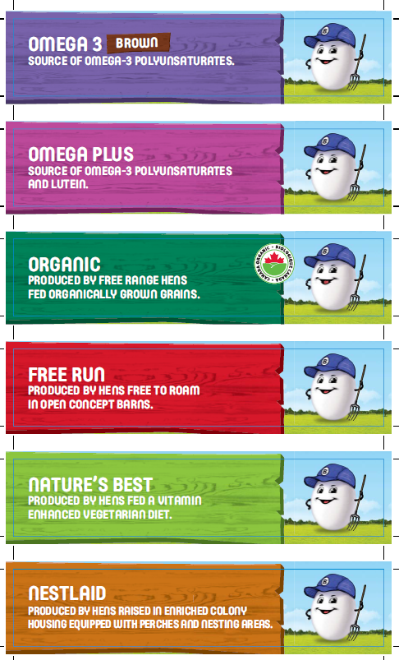
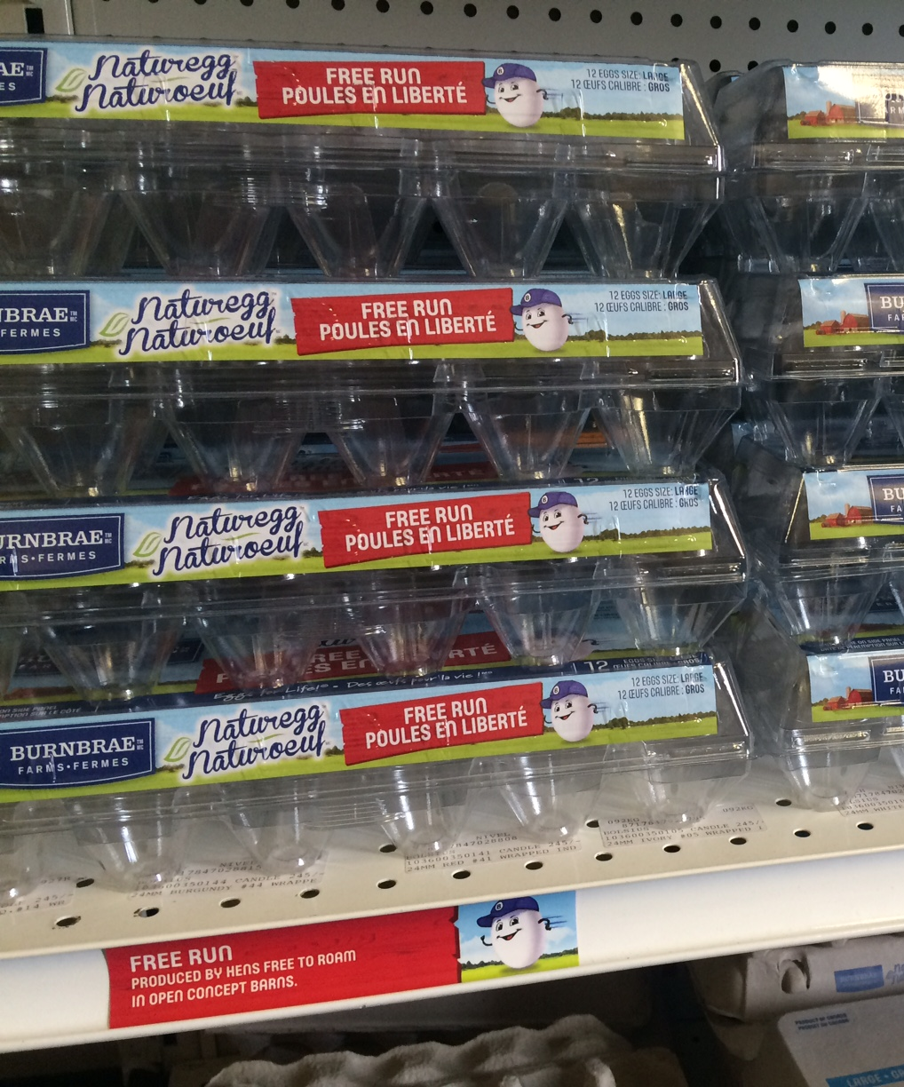
Communicating → In-store support

Slide 24
Implications for Retailers
After growing 30% in last 10 years… Are you dedicating enough space to eggs?
Given differing consumer preferences… Are you offering enough choice for all?
We all need to better educate on choices… How clearly “shop-able” is your section?
…we’d be happy to help you with this

Slide 25
Questions ?

