Slide 1

BEEF BRANDING –”GO-TO-MARKET”

Slide 2



MISSION
To be the best in all that we do, completely focused on our business, ensuring the best products and services to our customers, a relationship of trust with our suppliers, profitability for our shareholders and the opportunity of a better future for all our team members.
JBS CANADA ADVANTAGE
To be the best in all that we do, completely focused on our business, ensuring the best products and services to our customers, a relationship of trust with our suppliers, profitability for our shareholders and the opportunity of a better future for all our team members.

Slide 3







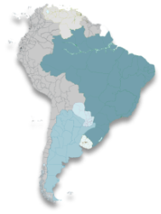
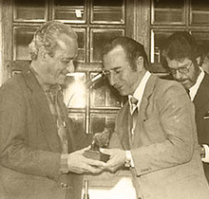




OUR HISTORY
The Beginning
1
Brazilian Growth
3
Welcome U.S
5
U.S Poultry Market
7
Europe & Case Ready
9
José Batista Sobrinho opens a small butcher shop with a capacity to process 5 head/day in Anápolis, Goiás, Brazil.
Operations expansion in beef sector through Brazil. Reaching slaughter capacity of 5,800 head/day
Acquisition Swift & Company in the United States, beef, pork and lamb markets.
Acquisition of Pilgrim’s Pride Corporation with operations in U.S, Mexico and Puerto Rico.
-Case Ready presence in U.S.
-Expansion U.K, and North Ireland.
1970-2001
2014-2015
1953
2007
2009
South America
Five Rivers
Expansion
First Acquisition
1968
Operations expansion: 21 plants in Brazil & 5 in Argentina increasing daily slaughter capacity to 19,900 head
2008
2013
Smithfield Beef Acquisition (U.S.) +
Five Rivers Cattle acquisition.
Acquisition of:
-XL Foods in Canada
-Seara in Brazil
-Zenda in Brazil
JBS acquires its first meatpacking plant in Planaltina , Brazil
2001-2006
2
4
6
8

Slide 4
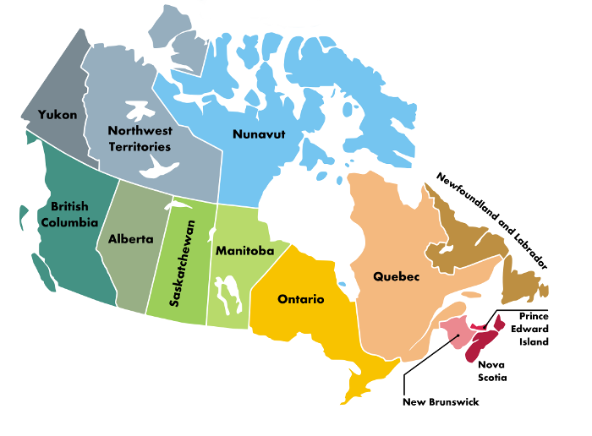

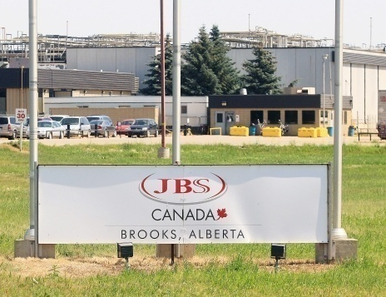

OUR LOCATION
CANADA
The City of Brooks is situated in Southern Alberta. (200 km East of Calgary and 100 km West of Medicine Hat)
“The City of 100 Hellos”
Population: 13,676
Over 100 languages are spoken.
Head Office
Home to over 3,000 new Canadians from over 100 different countries.
One of the most culturally diverse populations in Canada.
CALGARY
Plant
BROOKS
Lakeside Feeders

Slide 5

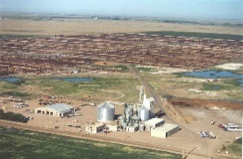
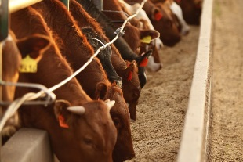


JBS CANADA ADVANTAGE
Committed to be a leader in all we do, ensuring the best products and services for our customers based on a relationship of trust and respect.
Recognized and valued Canadian/Alberta based employer of more than 2,600 members.
Federally inspected, HACCP approved beef processing facility with a daily capacity of managing on average 4,200 animals through 2 shifts.
Only Canadian operation with direct access to an integrated cattle feeding complement (75,000 animals) spanning just under 7,000 acres less than 1km from the production facility.
Incorporation and oversight for our own crop harvest, formula production and animal feeding.
Since 2013, a committed improvement and investment towards continued water usage reduction & improved overall water quality.
Since 2013, significant resources invested into people, processes, infrastructure, technology and overall best practices/attention to detail, in a committed effort towards safety, quality, consistency, uniformity, and ability to evolve with our partners.

Slide 6

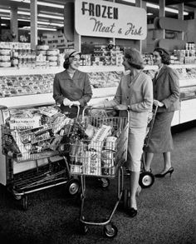

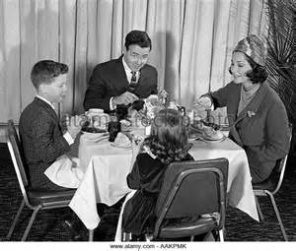


What Has Changed?

Slide 7
People have a new connection with food - an extension of who they are…
Consumers are more educated about what they eat
They want to know the story behind their food
They want food to be fresh, healthy, safe, and local where possible
Consumers want a highly customized experience
Everyone is accustomed to getting information, as well as products and services, immediately
Consumers are focused on food they perceive as healthy. They are concerned about additives, labelling, colorings, animal welfare, antibiotics, hormones, preservatives, GMOs and more…

Slide 8
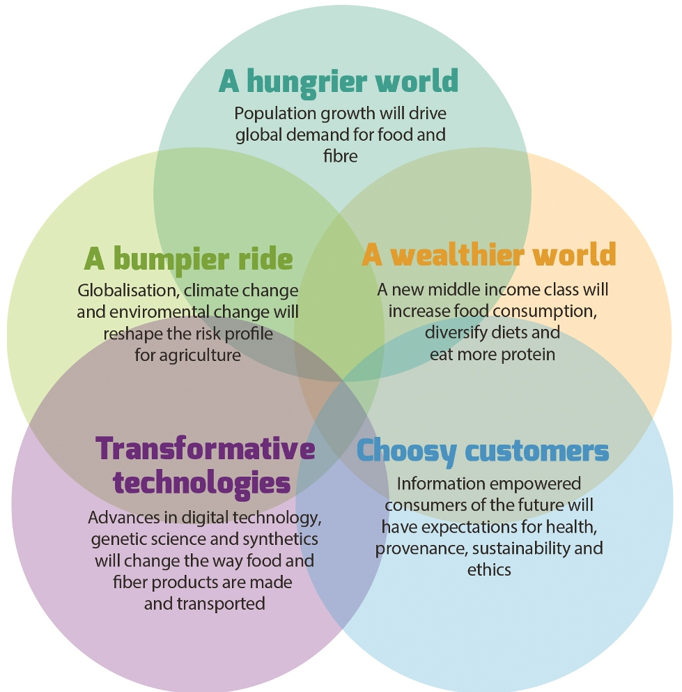

Slide 9
Food Integrity
PUBLIC VIEW: according to the Center for Food Integrity (www.foodintegrity.org) – “as consumers become more interested in how their food is grown, processed and brought to market, the food system must ensure it is doing the right things in a way that builds trust.”
CORPORATE VIEW: according to Chipotle – “serving better food made not only from fresh ingredients, but ingredients that are sustainably grown and naturally raised with respect for the animals, the land, and the farmers who produce the food.”
Quality
Safety
Food
Integrity
Authenticity

Slide 10

WILL BRAND IDENTITY = BRAND LOYALTY?

Slide 11

An expression and reflection of culture, character, ethics, values, personality – DNA of the very the products and services offered is
BRAND IDENTITY
Inspiring trust with employees, the communities in which we work/live, suppliers, customers and more over,
CONSUMERS
Only through trust can there be
BRAND LOYALTY

Slide 12
Consumer Behavior
Recognition of “Need/Desire” for Beef
Decision to Purchase/Consume Beef
Evaluation of Alternatives (Store/Restaurant)
Brand/Product/Choice/Selection
Consumption/Experience/Value Assessment
Emotional Evaluation
+/- Demand Cycle

Slide 13



Slide 15
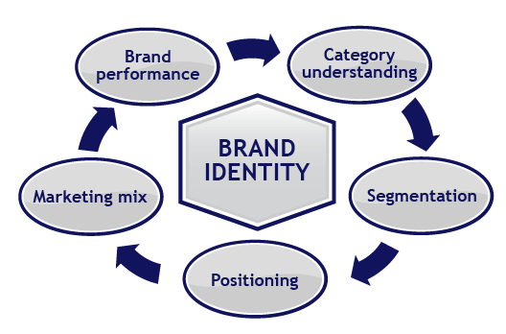

Slide 16


Slide 17
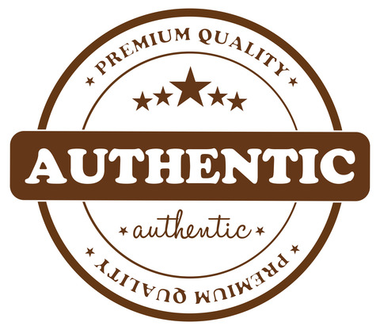

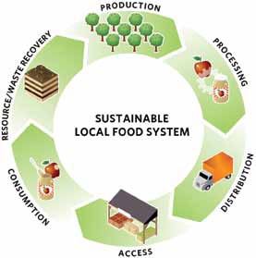
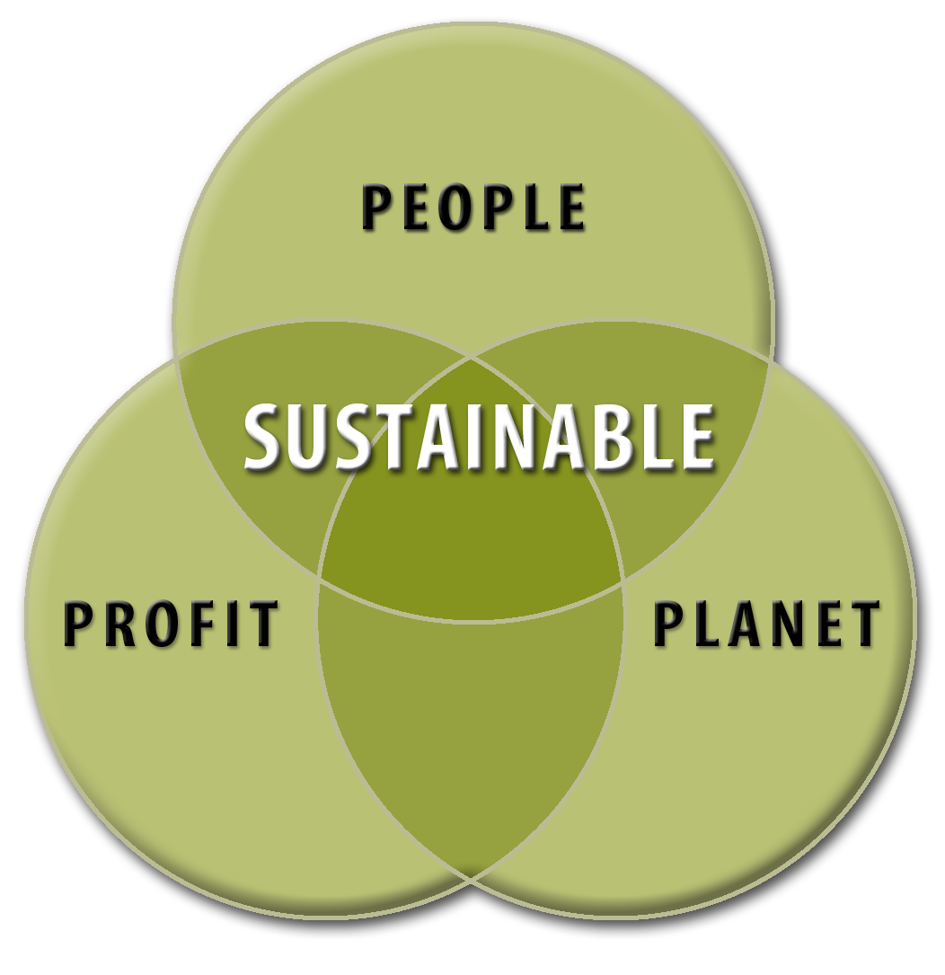


Branding – Beyond the Box “Go….NO…Go”
Authentic - genuine, bona fide mean being actually and exactly what is claimed. Implies being fully trustworthy.
Transparent - implies openness, communication, and accountability. It has been defined simply as the perceived quality of intentionally shared information.
Sustainable - A sustainable food system is a collaborative network that integrates several components in order to. enhance a community’s environmental, economic and social well-being.
Local - connect food producers and food consumers in the same geographic region; in order to develop more self-reliant and resilient food networks, improve local economies, or for health, environmental, community, or social impact in a particular place.

Slide 18



Slide 19


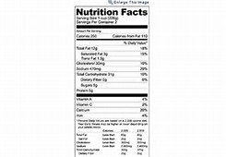




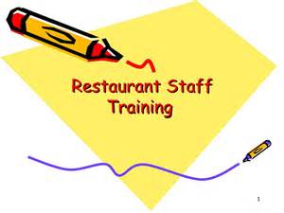
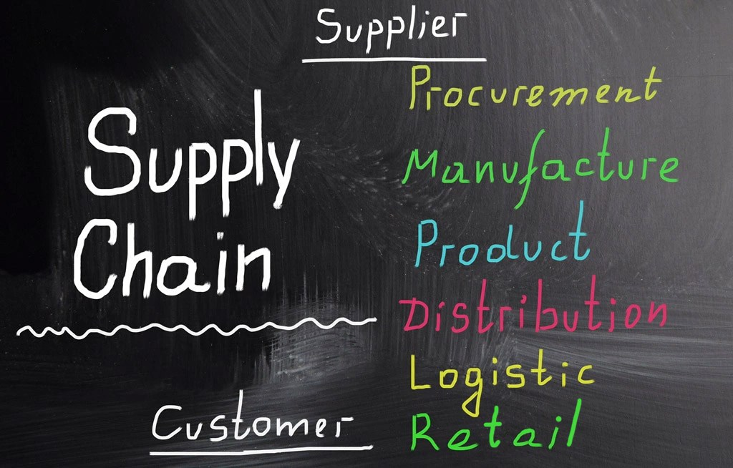
Branding – Know the Story/Check the Facts…
Know the FULL story – from farm to fork as it is often said provides an amazing story – do you know the details of every chapter?
Know your supplier – go beyond the box, look past the packaging and know your brands intimately from inputs to people, to processes, to the promise.
Educate and train your people – enable ambassadors of your brands. They need to know the story to share the story.

Slide 20
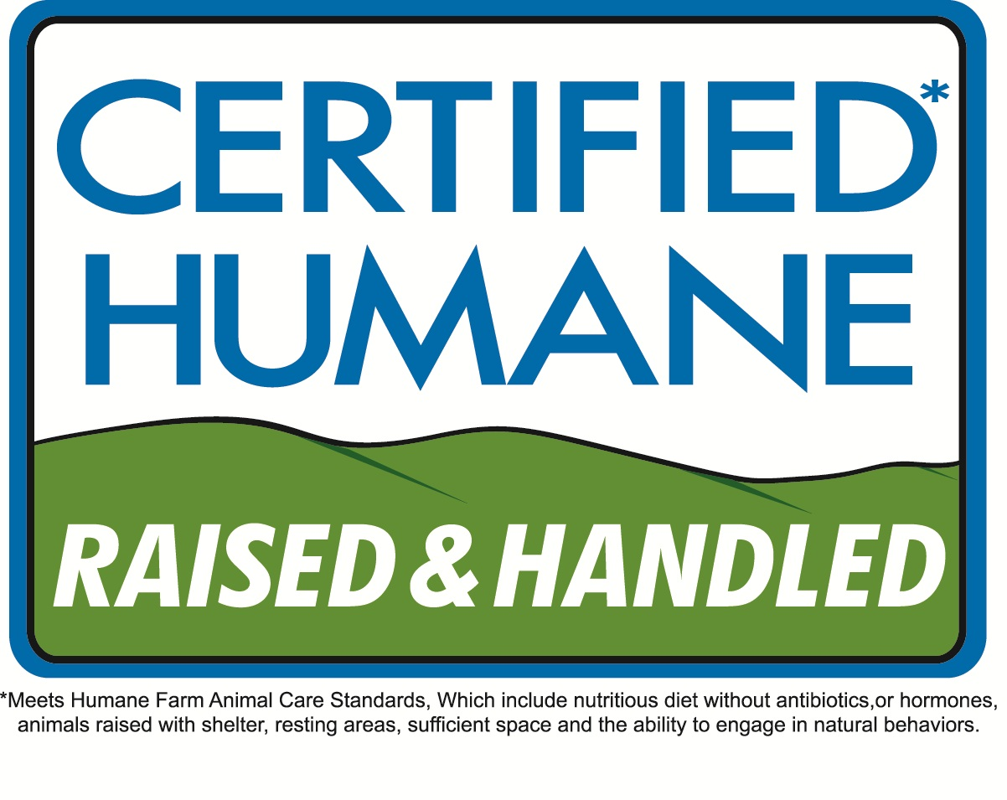

Slide 21




Domestic/Urban
Consumers
Emotional/
Ethics & Values
Millennials
Brand
&
Go-to-Market

Slide 22
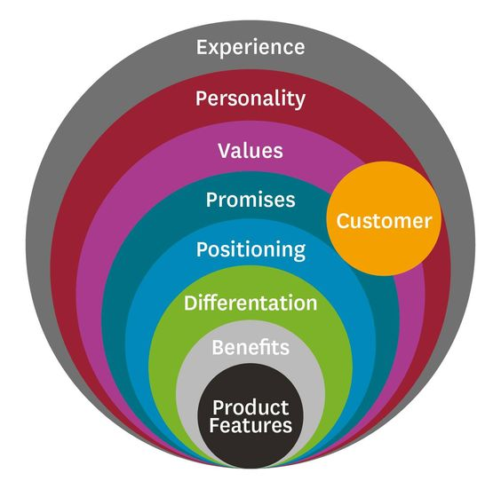

Slide 23
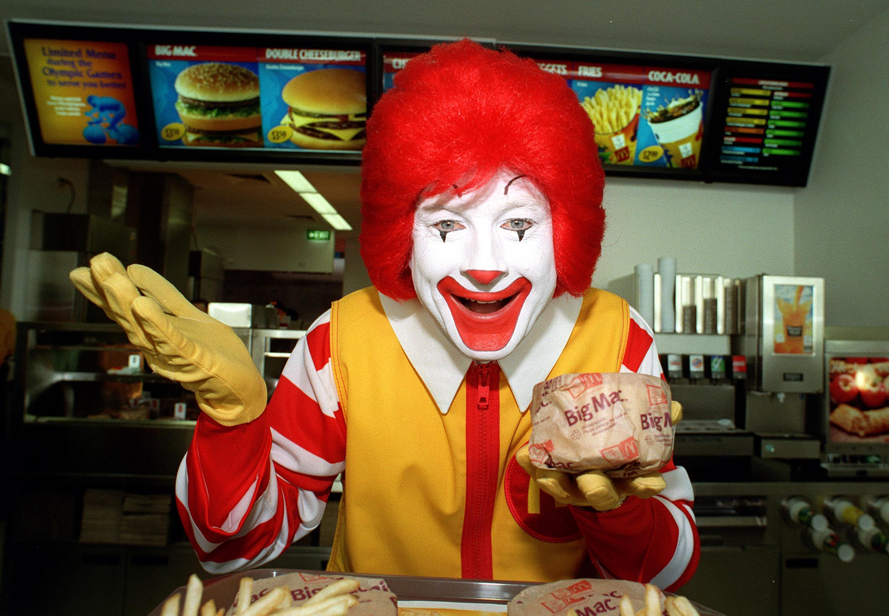

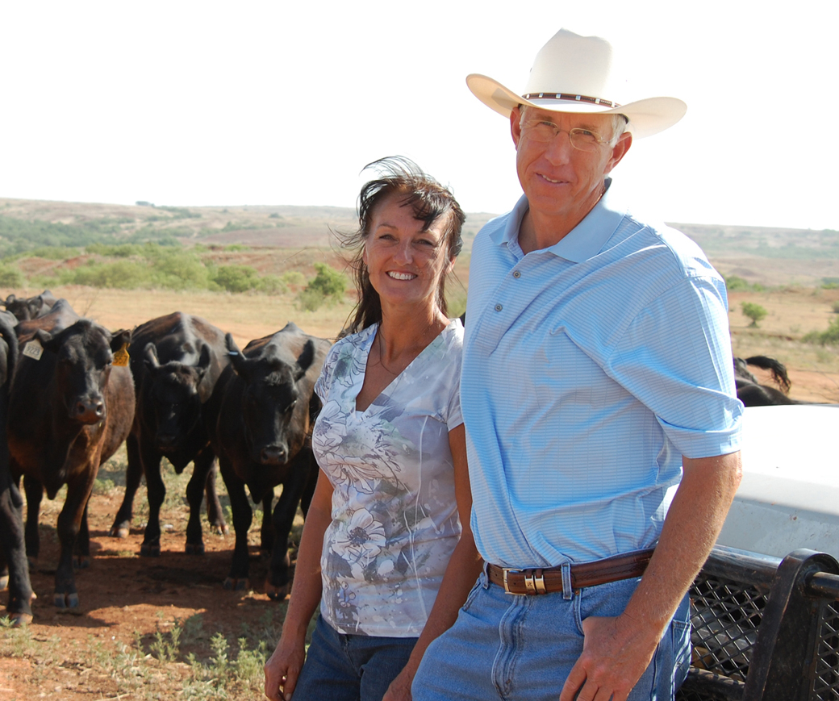
Branding to Domestic/Urban Consumers
The brand of beef you ‘commit to offer’ your customer/consumer needs to align with corporate values/ethics
Really get to know your customer/consumer and ensure you have found the ‘sweet spot’ for authentic and ethical reasons
Enable your employees/customers/consumers to be the ‘ambassador/advocate’ of your offerings – flyers/features/ads/packaging (really think through celebrity endorsement)
Resist the temptation of “marketing-to-make-money” - comes back to food integrity
Embrace the diversity of our Canadian population – talk with your beef supplier about cultural innovation/culinary relevance and provide products/information (e.g. recipes, website interactivity, videos, cooking demonstrations using your product)

Slide 24
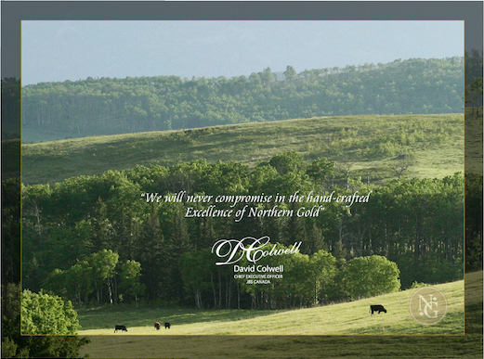

Slide 25
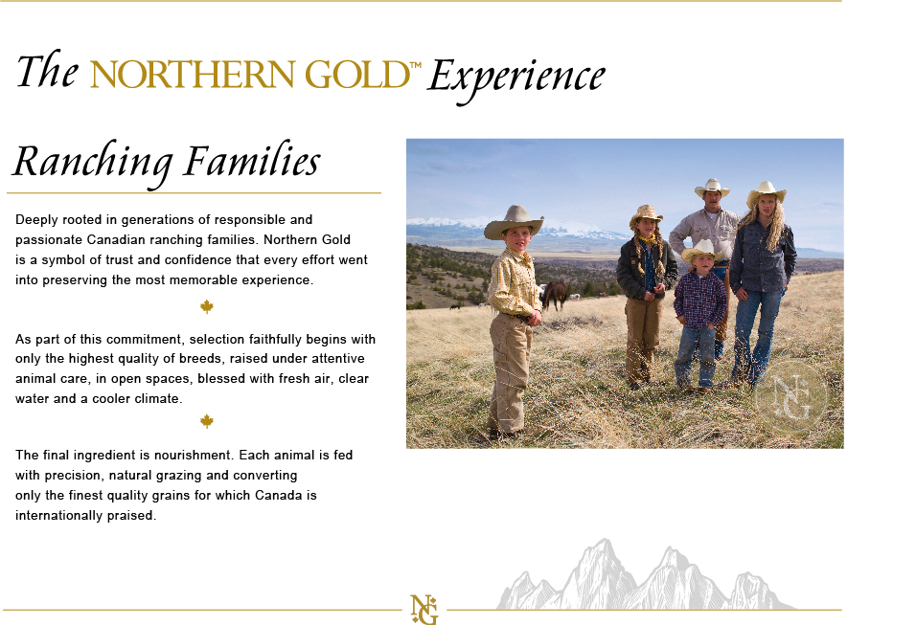

Slide 26
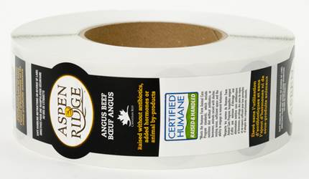
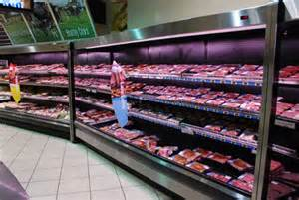
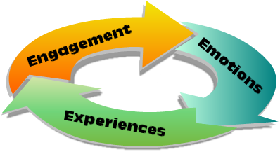
Branding to Emotional/Ethics/Values
Invest in & communicate “don’t advertise - INFORM” product health/wellness benefits so that your customers/consumers know what they’re getting in return for their loyalty to your beef brand/products
Communicate & educate “don’t forget” the versatility & practicality of your beef offerings “how the brand/product fits” = relevance
Provide a platform and true avenue for your customer/consumer to provide feedback and raise concerns knowing there will be a response – don’t just sell – provide service – this enhances the ‘emotional’ connection and is a key driver towards ‘trust’ = BRAND LOYALTY

Slide 27
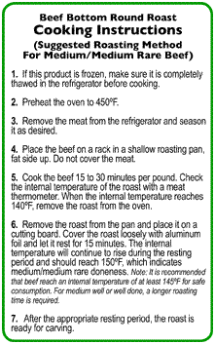
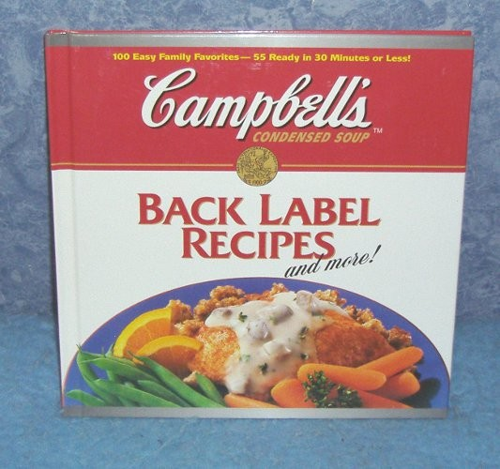
Branding to Millennials (avg. 18-33)
Research reports this is the group which most often considers themselves “a cook/amateur chef” – some would say “foodie”
Watch in-store videos about fresh meat (increasing trend in markets such as Asia focused on younger generations)
Visit websites to review, assess and compare brands/products “again the emotional/value connection”
Look for/search out on-line recipes – be their go-to source of information & creativity for beef – “most likely to buy an unfamiliar cut if they have a recipe – are increasingly seeking same on meat packaging
Incorporate a QR code – and ensure information is relevant, factual, cooking instructions, and remains current/creative – videos, quick facts, photos – call can then be shared by this consumer to their friends and family and community “they become advocates of your brands”
Keep it simple – make it fun – engage them in a ‘conversation’ – they don’t just want to buy your product – they want to experience the product and fit it into their lifestyle and “BRAND LOYALTY BASKET”

Slide 28
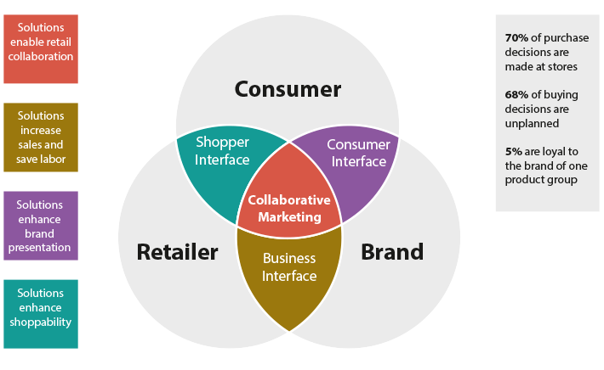

Slide 29



Slide 30
Leadership Team David Colwell – Chief Executive Officer Rob Meijer – Lead, Business Development, Brand & Marketing Marc Rehel – Manager, Business Development, Canadian Retail Shawn McKelvie – Manager Business Development, Canadian Food Service/Ground Beef

Slide 31
Thank you
Questions?

