Slide 1
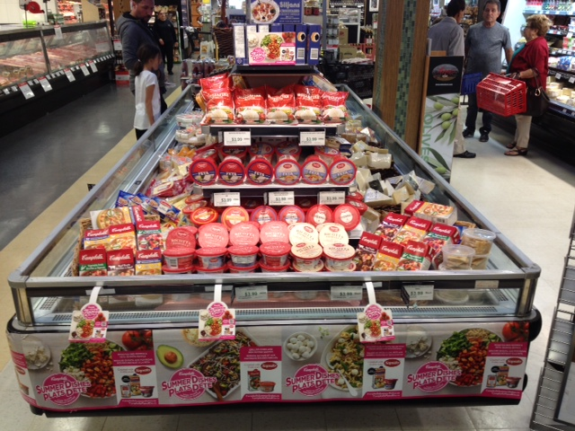
Campbell’s Promotion
Sales Rep: Anthony Rossi
ACCOUNT: Cataldi

