Slide 1
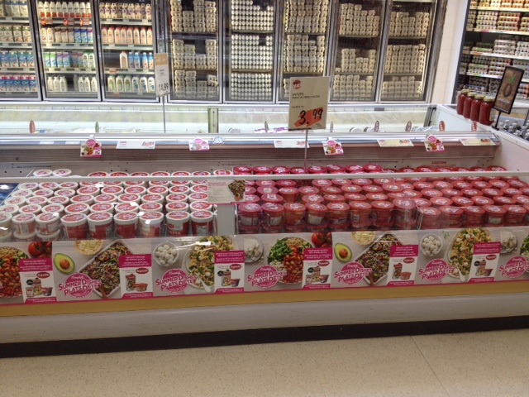
Coppa’s Fresh Market – Dufferin Location
Sales Rep: Anthony Rossi

