Slide 1



Slide 2
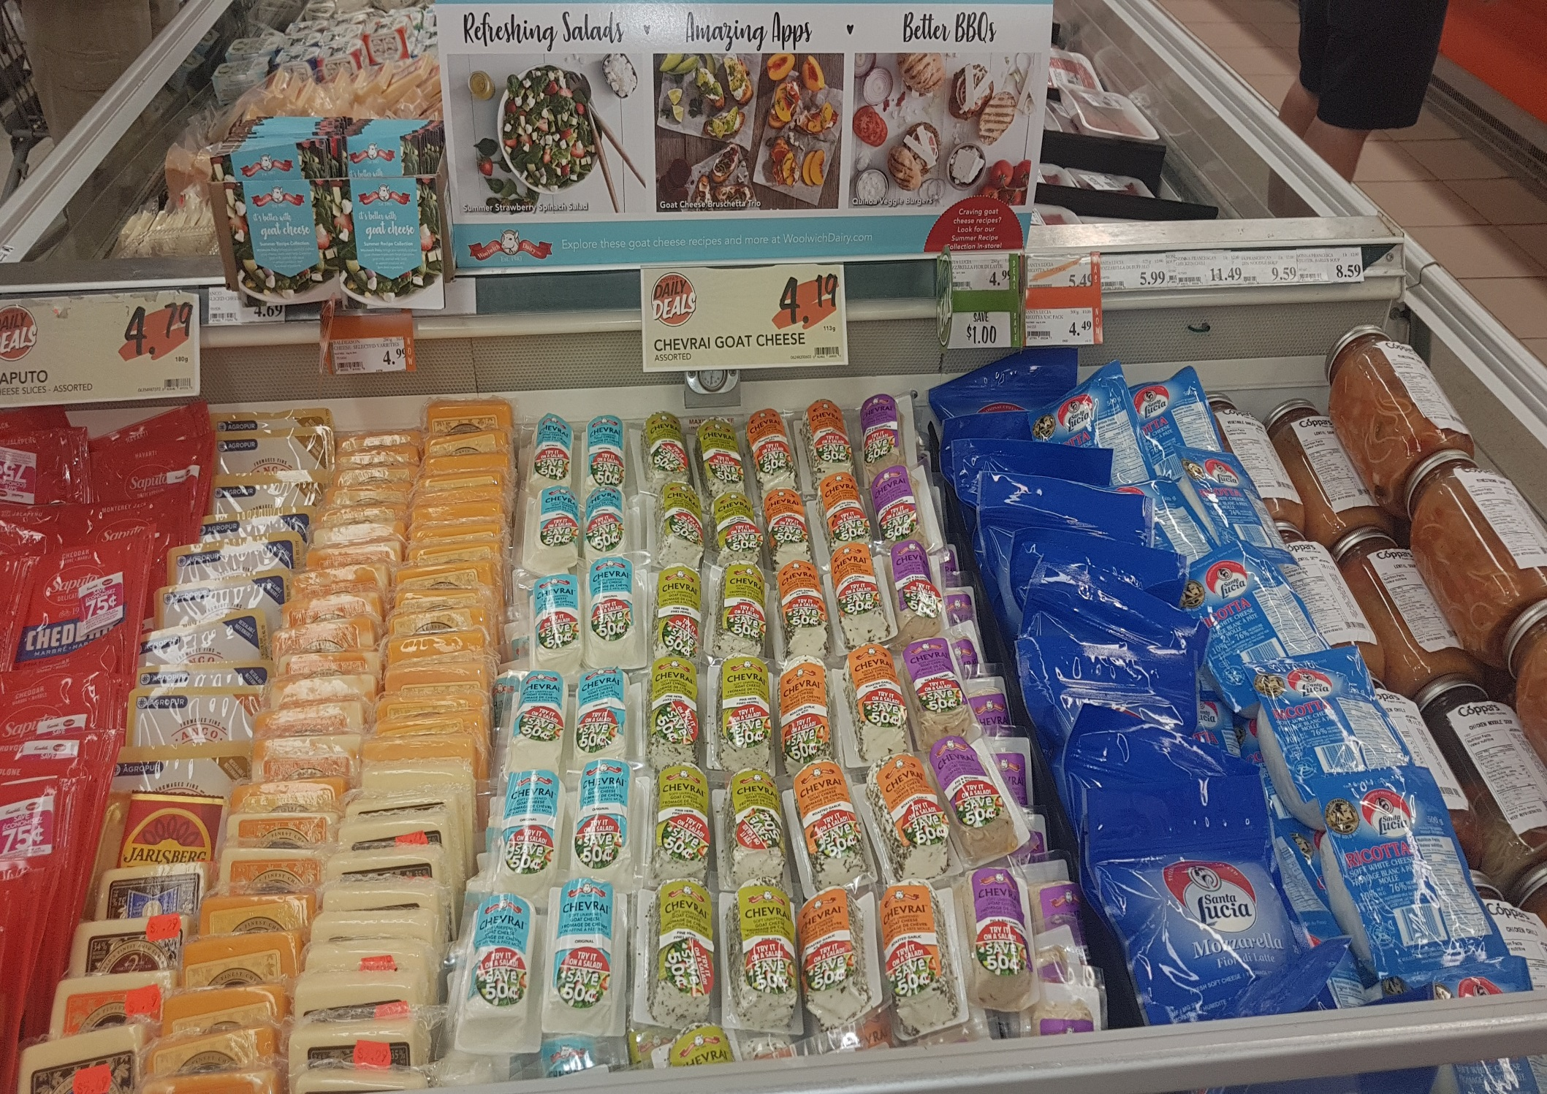
Coppa’s Fresh Market
148 Bennet Road
M1E 3Y3
Phone: (416) 282-5759
Manager: Violotta

