Slide 1
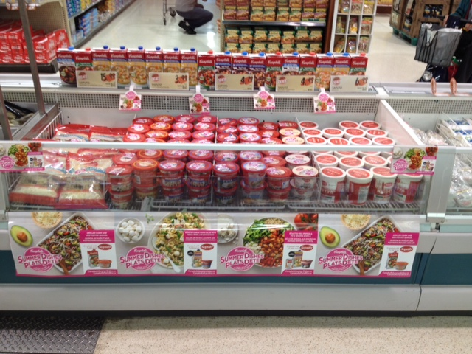
Coppa’s Fresh Market – King City Location
Sales Rep: Anthony Rossi

