Slide 1
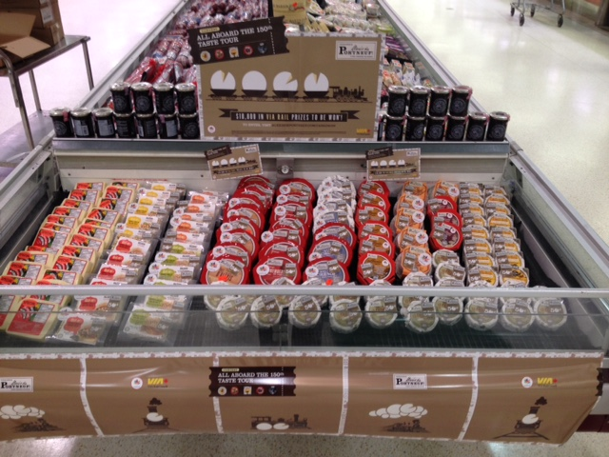

Insert Display Picture

