Slide 1



Slide 2
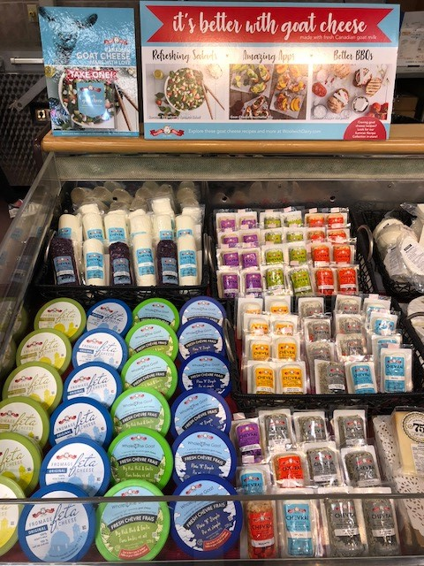
Grande Cheese Maple
Manager - Arian
9929 Keele st
Maple ont
L6A-1Y5
Sales Rep: Jason Lichter

