Slide 1

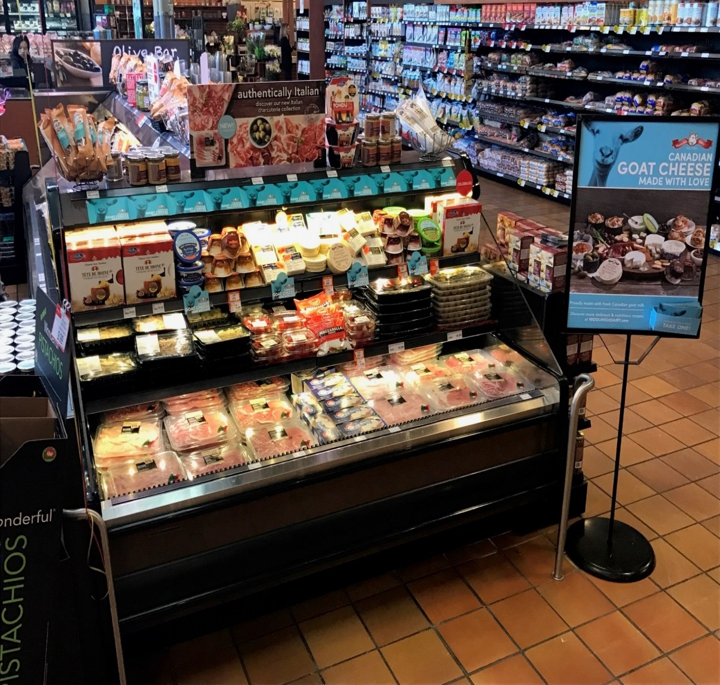
Woolwich March/April 2018
Longos Markham
3085 Highway #7
Markham, Ontario
Store manager : Chris Didmomneico
Sales Rep Jason L

