Slide 1
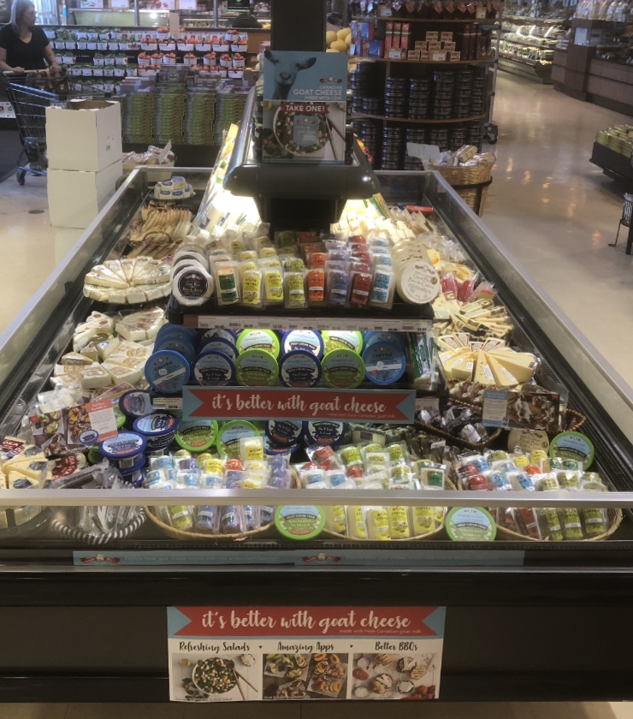
Woolwich Summer 2018
Yummy Market Maple
1390 Major Mackenzie Drive
Maple, Ont
L6A-4H6
Store manager : Peter K Sales Rep Jason L

